Slide 1
Machine Learning
Lab 7 : Support Vector machine

Slide 2
Classification
Classification
Binary
Multi-class

Slide 3
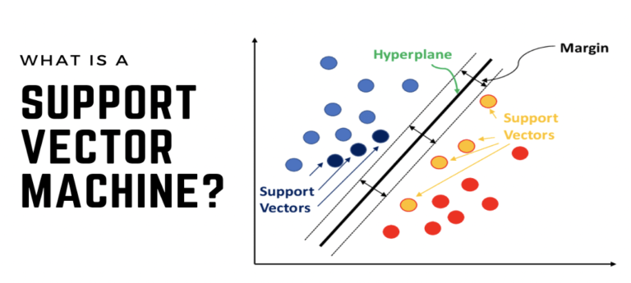
Support Vector Machine

Slide 4
SVM VS. LINEAR REGRESSION
 | Linear Regression | SVM
Task | Regression | Classification or Regression
Relationship | Linear | Linear or non-linear
Optimize for | Least square error | Maximum margin
Sensitive to outliers (Noise) | Yes | Less sensitive
Interpretation | Easier | More complex

Slide 5
SVM: Characteristics
Focuses on margins
Finding optimal hyperplane
Widest margin
Less sensitive to outliers

Slide 6
SVM: Strengths
High-dimensional data
Robust to noise
Generalization performance
Non-linear relationship
Memory efficient
Performance efficient
Classification and regression

Slide 7
SVM: Limitations
Computational cost for large dataset.
Requires Kernel selection and tuning.
Interpretability
Sensitive to feature scaling
Not ideal for missing data
Potential to overfitting

Slide 8
Types of Kernels
Kernels
Linear
(Straight Line)
Polynomial
(Curved)
Gaussian “RBF”
(Flexible)
Sigmoid
(Similar to NN)

Slide 9
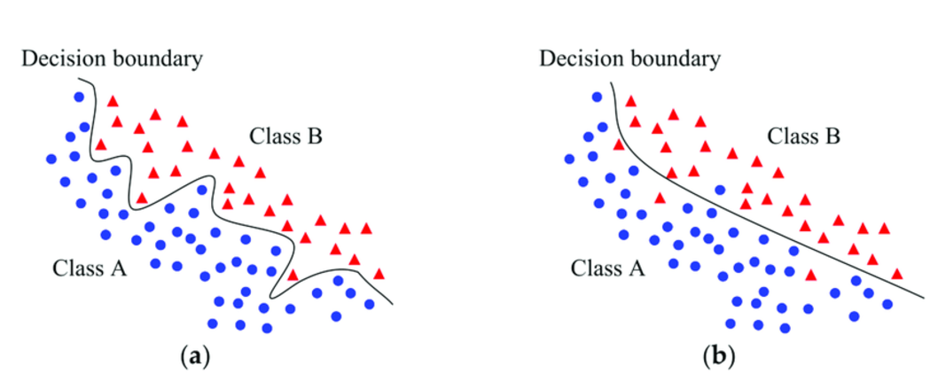
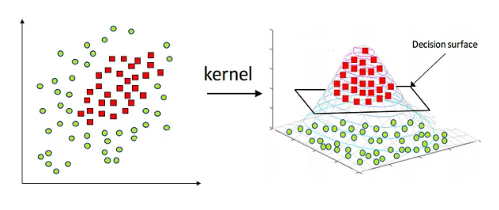
Kernels

Slide 10


Hyperparameters Impact
C
Gamma
Controls strictness
High $→$overfitting
Low $→$underfitting
Controls Curve Complexity
High $→$Very Wiggly
Low $→$ Smooth

